Slide 1
The Economics of Entrepreneurship & Innovation: Nice Summer School
David B. Audretsch

Slide 2
What is Entrepreneurship Research?
Organizational Context
--Small Firm (SME)
--New Firm(Startup)
--(Nascent) Individual
--Business Owner
Behavior
--Opportunity Recognition/Creation
--Opportunity Exploitation
Performance
--Innovation
--Growth (Gazelles)

Slide 3
Organizational Context
Small Firm (SME)
New Firm(Startup)
(Nascent) Individual
Business Owner

Slide 4
Behavior
Opportunity Recognition
Opportunity Creation
Opportunity Evaluation
Opportunity Exploitation

Slide 5
Performance
Innovation
Growth (Gazelles)
Social Goals (Social Entrepreneurship)

Slide 6
An Overview of Entrepreneurship Literature
Acs, Zoltan J. and David B. Audretsch, 2010, “Introduction to the Second Edition” in Z.J. Acs and David B. Audretsch (eds.), The Handbook of Entrepreneurship Research (New York: Springer)
Parker, Simon, 2009, The Economics of Entrepreneurship (Cambridge: Cambridge University Press).

Slide 7
The Historical Perspective
Entrepreneurship as a Marginal or Invisible Field
Small Business Research
Mittelstandsforschung in Germany
KMU Forschung

Slide 8
The Historical Perspective

Slide 9
The Demise of Entrepreneurship
“Since capitalist enterprise, by its very achievements, tends to automize progress, we conclude that it tends to make itself superfluous – to break to pieces under the pressure of its own success. The perfectly bureaucratic giant industrial unit not only ousts the small- or medium-sized firm and ‘expropriates’ its owners, but in the end it also ousts the entrepreneur and expropriates the bourgeoisie as a class which in the process sands to lose not only in its income but also, what is infinitely more important, its function.”
Joseph Schumpter, 1942, Capitalism and Democracy

Slide 10
Policy Mandate for Entrepreneurship to Promote Innovation & Economic Growth
“Our lacunae in the field of entrepreneurship needs to be taken seriously because there is mounting evidence that the key to economic growth and productivity improvements lies in the entrepreneurial capacity of an economy”
EU President, Romano Prodi
2002
Notes:
Why not “Evolving from Physical Capital...“ (Moving / Shifting / …)

Slide 11
Innovation at the Firm Level

Slide 12

The Model of the Knowledge Production Function
I$=f\left(K\right)$
$I=$ αRD^{β}∙HKᵑ∙Є
Where I is innovative output and
K is Knowledge, and RD is R&D, HK is human capital

Slide 13
Testing the Schumpeterian Hypothesis
Firm Innovative Output is Positively Related to Firm Size
Empirical Evidence β≥0
Measurement Issues
Innovation -- Inputs (R&D), Intermediate Outputs (Patents), Outputs

Slide 14
The Schumpeterian Paradox
Empirical Evidence for Innovative Output Measures find β≤0

Slide 15
Resolving the Schumpeter Paradox: Knowledge Spillovers
E_{i}=f (K_{j})
Where E is the startup of a new firm i and j refers to an incumbent organization.
The knowledge production function reconsidered – the knowledge is exogenous and the creation of a new firm is endogenous

Slide 16
How is Knowledge Different?
Non-excludable & non-exhaustive
(Arrow, 1962)
Hyper uncertainty, asymmetries & transactions cost
(Arrow, 1962)

Slide 17
The Knowledge Filter
“A wealth of scientific talent at American colleges and universities – talent responsible for the development of numerous innovative scientific breakthroughs each year – is going to waste as a result of bureaucratic red tape and illogical government regulations…What sense does it make to spend billions of dollars each year on government-supported research and then prevent new developments from benefiting the American people because of dumb bureaucratic red tape?”
U.S. Senator Birch Bayh, 1980

Slide 18


Slide 19


Slide 20

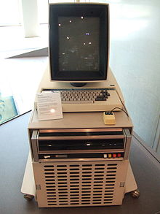
Xeorx PARC’s Discarded Inventions

Slide 21
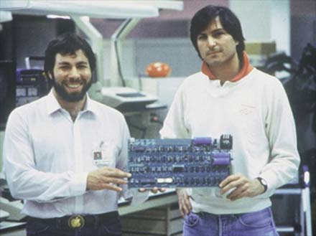
Apple Computer Founders

Slide 22
Knowledge Spillover Theory of Entrepreneurship
Entrepreneurship - Innovation - Growth
Behavior- Organization- Performance

Slide 23
Knowledge Spillover Entrepreurship
Acs, Zoltan J. and David B. Audretsch, 2010, “Knowledge Spillover Entrepreneurship,” in Z.J. Acs and D.B. Audretsch (eds.), Handbook of Entrepreneurship Research (New York: Springer).
Cohen, W. and Levinthal, D. (1989). Innovation and Learning. The Economic Journal, 99, 569-596.
Griliches, Z. (1992). The Search for R&D Spillovers. Scandinavian Journal of Economics, 94, 29-47.
Zucker, L., Darby, M. and Armstrong, J. (1998). Intellectual Human Capital and the Birth of U.S. Biotechnology Enterprises. American Economic Review, 88, 290-306.

Slide 24
Silicon Valley Semi-Conductor Spinoffs
Bell Labs
Shockley Transistor (1955)
Fairchild Semi-Conductor (1957)
National Semiconductor (1967)
Rheen Semiconductor (1959)
Amelco (1961)
Signetics (1961)
General Micro-electronics(1963)
Molectro (1962)
Raytheon Semiconductor (1961)
Cal. Dak (1965)
ISY Haas (1968)
Philico-Ford Micro Electronics (1966)
Electronic Arrays (1967)
American Micro-Systems (1966)
R. Norman (1968)
UnionCarbide Electronics (1964)
Intersil (1967)

Slide 25
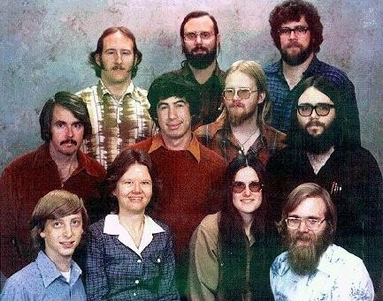
Microsoft Founding Team

Slide 26
Spinoffs
Klepper, Steven, 1996, “Entry, Exit, Growth, and Innovation over the Product Life Cycle,” American Economic Review, 86, 562-583.
Klepper, Steven and S. Sleeper, 2005, “Entry by Spinoffs,” Management Science, 21, 97-1016.

Slide 27
Two Dimensions of Knowledge Spillovers
Geography – Clusters within Close Spatial Proximity to Knowledge Source
(Adam B. Jaffe, Manuel Trajtenberg, and Rebecca Henderson, 1993, “Geographic Localization of Knowledge Spillovers as Evidenced by Patent Citations,” Quarterly Journal of Economics; Annalee Saxenian, 1994, Regional Advantage; Harvard University Press.)
Organizational – Role of Entrepreneurial New Firms as Conduit of Knowledge Spillovers
(R. Agarwal et al., “The Process of Creative Construction: Knowledge Spillovers, Entrepreneurship and Economic Growth,”,” Strategic Entrepreneurship Journal, 2008.

Slide 28
The Geography of Innovation

Slide 29
The Cluster Context
Cluster: “The location of complementary and interacting firms, individuals and institutions within close geographic proximity”
Michael Porter, “firms in downstream industries (that is channels or customers); producers of complementary products; specialized infrastructure providers; government and universities, think tanks, vocational training providers); and standards/setting agencies”
(M.E. Porter, “On Competition,” Harvard Business School Publishing, 1999, p. 199.)

Slide 30
Stylized Facts for Geographic Clusters
Emergence of Knowledge-Based Clusters
(AnnaLee Saxenien, Regional Advantage, Harvard University Press, 1994)
Innovative Activity Clusters within Close Geographic Proximity Around Knowledge Sources
(D. Audretsch & M. Feldman, “R&D Spillovers and the Geography of Innovation and Production,” American Economic Review, 1996, 630-640)

Slide 31
Example: Silicon Valley
“It is not simply the concentration of skilled labor, suppliers and information that distinguish the region. A variety of regional institutions – including Stanford University, several trade associations and local business organizations, and a myriad of specialized consulting, market research, public relations and venture capital firms – provide technical, financial, and networking services which the region’s enterprises often cannot afford individually. These networks defy sectoral barriers: individuals move easily from semiconductor to disk drive firms or from computer to network makers…This decentralized and fluid environment also promotes the diffusion of intangible technological capabilities and understandings.”
(AnnaLee Saxenien, Regional Advantage, Harvard University Press, 1994)

Slide 32
Stylized Facts for Geographic Clusters - 2
Knowledge-Based Clusters Exhibit Higher Rates of Economic Growth
(Ed Glaeser et al., “Growth of Cities,” Journal of Political Economy, 1992)
Cluster Growth is Promoted by Diversity Rather than Specialization of Knowledge Resources
(M. Feldmann & D. Audretsch, “Innovation in Cities,” European Economic Review, 1999.

Slide 33
Stylized Facts for Geographic Clusters - 3
New-Venture Growth Greater in Cluster Context than in Non-Cluster Context
(B. Gilbert et al., “Clusters, Knowledge Spillovers and New Venture Performance: An Empirical Examination,” Journal of Business Venturing, 2007; D. Audretsch & E. Lehmann, “Does the Knowledge Spillover Theory of Entrepreneurship hold for regions?”, Research Policy, 2005, 1191-1202.

Slide 34
Stylized Facts for Geographic Clusters - 4
New Venture Creation Greater in Cluster Context
(D. Audretsch et al., 2005, “University Spillovers and New Firm Location,” with Erik E. Lehmann and Susanne Warning, Research Policy.)
Locational Sources Provide Capabilities & Knowledge to New Ventures in Cluster Context Creating High Performing Firms
(S. Klepper, 2007, “Disagreements, Spinoffs, and the Evolution of Detroit as the Capital of the U.S. Automobile Industry,” Management Science, 616–631 and R. Agarwal et al., 2004. “Knowledge Transfer through Inheritance: Spin-Out Generation, Development and Performance. Academy of Management Journal, 501-522.)

Slide 35
Industry Evolution

Slide 36
Stylized Facts of Entrepreneurship Dynamics
New Firm Survival positively related to age and size
New Firm Growth negatively related to age and size
Survival and Growth effects more pronounced in knowledge industries
Caves, Richard E.,1998, “Industrial Organization and New Findings on the Turnover and Mobility of Firms,” Journal of Economic Literature
Sutton, John, 1997, “Gibrat’s Legacy,” Journal of Economic Literature

Slide 37
Theory of Noisy Learning & Selection
Jovanovic, Boyan, 1982, "Selection and Evolution of Industry," Econometrica
Richard Ericson and Ariel Pakes, 1995, “Markov-Perfect Industry Dynamics: A Framework for Empirical Work,” Review of Economic Studies,
Hugo A. Hopenhayn, 1992, “Entry, Exit and Firm Dynamics in Long Run Equilibrium,” Econometrica

Slide 38
Entrepreneurship & Growth
D
Survival Trajectory
Performance
Returns
Wages
B
Incumbent Firm
B
A
B
Failure Trajectory
C
Time

Slide 39
Entrepreneurship in Evolutionary Context
Model of Revolving Door – Turbulence
Model of Displacement
David B. Audretsch, Innovation and Industry Evolution (MIT Press, 1995)
Caves, Richard E.,1998, “Industrial Organization and New Findings on the Turnover and Mobility of Firms,” Journal of Economic Literature

Slide 40
Entrepreneurship: Model of Occupational Choice

Slide 41
Model of Entrepreneurial Choice
Pr (E)= f(∏_{i}* - W_{j})
Where
E is the startup of a new firm
∏* is expected profits associated with new firm i
Wis the wage associated with being a worker for an incumbent firm j

Slide 42
Entrepreneurial Opportunities
Alvarez, Sharon, Jay B. Barney and Susan L. Young, 2010, “Debates in Entrepreneurship: Opportunity Formation and Implications for the Field of Entrepreneurship,” in Z.J. Acs and D.B. Audretsch (eds.), Handbook of Entrepreneurship Research (New York: Springer).
Sarasvathy, Saras D., Nicholas Dew, and S. Ramakrishna, 2010, “Three Views of Entrepreneurial Opportunity,” in Z.J. Acs and D.B. Audretsch (eds.), Handbook of Entrepreneurship Research (New York: Springer).
Shane, Scott and Johanthan T. Eckhardt, 2010, “An Update to the Individual-Opportunity Nexus,” in Z.J. Acs and D.B. Audretsch (eds.), Handbook of Entrepreneurship Research (New York: Springer).

Slide 43
Where Do Entrepreneurial Opportunities Come From?
Knowledge Spillover Theory of Entrepreneurship: Knowledge embedded in economic agents is exogenous, and in an effort to appropriate the returns from that knowledge, the spillover of knowledge involves endogenously creating a new firm

Slide 44
Endogenous Entrepreneurship
Appropriation Problem – Firm vs. Knowledge Agent
New firms are endogenous response to knowledge not completely & exhaustively commercailized
Knowledge exogenous and embedded in economic agents who endogenously start new firms to appropriate knowledge endowments

Slide 45
The Labor Market View
Brown, C. and J. Medoff, 1989, “The Employer Size Wage Effect,” Journal of Political Economy, 97, 1027-1059.
Davis, S., Haltiwanger, J. and Schuh, S., 1996a, Job Creation and Destruction. Cambridge: MIT Press.
Davis, S., Haltiwanger, J. and Schuh, S., 1996b, Small Business and Job Creation: Dissecting the Myth and Reassessing the Facts. Small Business Economics, 8, 297-315.

Slide 46
Linking Entrepreneurship to Economic Growth
Carree Martin A. and A. Roy Thurik, 2010, “The Impact of Entrepreneurship on Economic Growth,” in Z.J. Acs and D.B. Audretsch (eds.), Handbook of Entrepreneurship Research (New York: Springer).
Audretsch, David B., 2007, “Entrepreneurship Capital and Economic Growth,” Oxford Review of Economic Policy, Vol. 23 (1), 2007, 63-78.
Audretsch, David B., Max Keilbach and Erik Lehmann, 2008, Entrepreneurship and Economic Growth (New York: Oxford University Press).
Braunerhjelm, Pontus, Zoltan J. Acs, David Audretsch and Bo Carlsson, 2010, “The Missing Link: Knowledge Diffusion and Entrepreneurship in Endogenous Growth,” Small Business Economics An Entrepreneurship Journal, 34 (2), February, 105-125.

Slide 47
The Romer Model

Slide 48
Economic Growth Hypothesis
Q_{i} = h(t)f (C_{i}, L_{i}, K_{i}, E_{i})
  Given a level of knowledge investment and severity of the knowledge filter, higher levels of economic growth should result from greater entrepreneurial activity, since entrepreneurship serves as a mechanism facilitating the spillover and commercialization of knowledge.

Slide 49
Entrepreneurship Capital’s Role

Slide 50
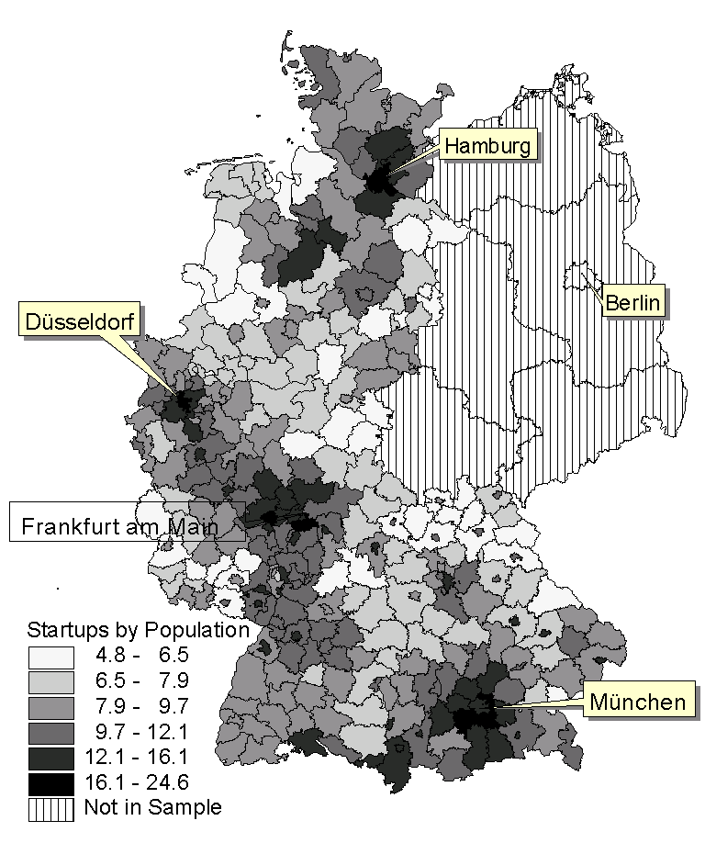
Entrepreneurship in German Regions

Slide 51
Estimation of Regional Labor Productivity
Table 4: Results of Estimation of the Model of Labor Productivity in German Regions
 | (1) | (2) | (3) | (4) | (5)
Constant | 1.888*** | -2.175*** | -1.645*** | -1.730*** | -1.299***
 | (-19.235) | (-16.683) | (-5.566) | (-6.060) | (-6.060)
Capital Intensity | 0.332*** | 0.283*** | 0.283*** | 0.296*** | 0.293***
 | (6.814) | (5.535) | (5.551) | (5.747) | (5.807)
Knowledge |  | 0.035*** | 0.030*** | 0.030*** | 0.021**
 |  | (3.673) | (3.028) | (3.005) | (2.032)
Entrepreneurship |  |  | 0.107**
 |  |  | (1.993)
High-Tech Entrepreneurship |  |  |  | 0.044*
 |  |  |  | (1.747)
ICT Entrepreneurship |  |  |  |  | 0.102***
 |  |  |  |  | (3.203)
R² | 0.125 | 0.169 | 0.179 | 0.177 | 0.195

Slide 52
Estimating Entrepreneurship and Economic Performance
 | Dependent Variable: Regional Output
Constant | 1.0003*** (3.00) | 0.5316* (1.73) | 0.645* (1.94) | 1.0061*** (2.79)
Capital | 0.2001 (7.07) | 0.2022*** (7.69) | 0.2069*** (7.76) | 0.1923*** (6.52)
Labor | 0.7045*** (18.54) | 0.6854*** (20.53) | 0.6835*** (20.06) | 0.7075*** (17.94)
Knowledge | 0.0244** (2.29) | 0.0200* (1.73) | 0.0246** (2.13) | 0.0334*** (3.27)
General Entrepreneurship | 0.5230*** (6.84)
High Tech Entrepreneurship |  | .2496*** (6.38)
ICT Entrepreneurship |  |  | .2767*** (5.85)
Low Tech Entrepreneurship |  |  |  | .5078*** (6.33)
R2 | .9336 | .9453 | .9402 | .9326
Growth of West German Regions 3SLS Estimation

Slide 53
Knowledge Spillover Theory Testing
3SLS Estimation
 | Dependent Variable: Entrepreneurship
 | General | High Tech | ICT | Low Tech
Constant | -5.9748*** (-22.86) | -9.7557*** (-25.28) | -8.6529*** (-24.13) | -6.1225*** (-22.32)
Growth | 0.2765* (1.81) | 0.7999*** (3.51) | 0.6481*** (3.05) | 0.2061 (1.27)
Investment | -0.0034*** (-4.28) | -0.0049*** (-4.24) | -0.0047*** (-4.33) | -0.0031*** (-3.78)
Unemployment | 0.0010 (0.18) | -0.0320*** (-4.04) | -0.0277*** (-3.72) | 0.0064 (1.15)
Agglomeration | 0.00003 (1.05) | 0.0002*** (3.98) | 0.0001*** (3.38) | 0.00001 (0.40)
Standard Attractiveness | 0.0648 (0.65) | -0.0617 (-0.42) | 0.1759 (1.27) | 0.0597 (0.57)
Social Diversity | 0.0495 (0.35) | 1.0475*** (4.90) | 0.4013** (2.03) | -0.0508 (-0.34)
Policy | -0.00003 (-0.83) | -0.00004 (-0.83) | -0.0001** (-2.52) | -0.00002 (-0.62)
Taxes | 0.0007*** (4.30) | 0.0008*** (3.78) | 0.0008*** (4.05) | 0.0007*** (4.02)
Knowledge | 0.3293 (1.59) | 1.0435*** (3.45) | 0.7908*** (2.77) | 0.1581 (0.73)
Human Capital Diversity | 0.1264 (0.44) | 0.5968 (1.40) | -0.4222 (-1.06) | 0.0997 (0.33)
Industry Diversity | 0.7544*** (4.98) | 0.7385*** (3.36) | 0.8147*** (3.94) | 0.8016*** (5.02)
R² | 0.3024 | 0.5248 | 0.4253 | 0.2423

Slide 54
Regional Differences by
Growth
High Growth Regions
High knowledge investments
Low knowledge filter
High level of Entrepreneurship Capital
Low Growth Regions
Low Knowledge Investments
High knowledge filter
Low level of Entrepreneurship Capital

Slide 55
The Role of Public Policy
Henrekson, Magnus and Mikael Stenkula, 2010, “Entrepreneurship and Public Policy,” in Z.J. Acs and D.B. Audretsch (eds.), Handbook of Entrepreneurship Research (New York: Springer).
Lerner, Josh, 2010, “Boulevard of Broken Dreams: Why Public Efforts to Boost Entrepreneurship and Venture Capital Have Failed –And What do Do About It,” by Josh Lerner, Journal of Economic Literature, 98(4), December, 1053-1054.

Slide 56
New Research Directions

