Slide 1
Evolutionary Economic Geography: relatedness and diversification
Ron Boschma
Center of Innovation, Research and Competence in the Learning Economy (CIRCLE), Lund University
Urban and Regional research centre Utrecht (URU),
Utrecht University
lecture
KID Summer School, Nice
6 July, 2015

Slide 2
structure of lecture
related variety and regional growth
regional diversification based on relatedness
entrepreneurship: spatial evolution of an industry

Slide 3
reading list
Frenken, K, F Van Oort & T Verburg (2007) Related variety, unrelated variety and regional economic growth, Regional Studies 41, 685-697
Neffke, F., M. Henning and R. Boschma (2011) How do regions diversify over time? Industry relatedness and the development of new growth paths in regions, Economic Geography 87, 237-265
Boschma R & G Capone (2015) Institutions and diversification: Related versus unrelated diversification in a Varieties of Capitalism framework, Papers in Innovation Studies,2015/15, CIRCLE, Lund University
Klepper, S. (2007) Disagreements, spinoffs and the evolution of Detroit as the capital of the U.S. automobile industry, Management Science 53 (4), 616-631
Boschma, R.A. and R. Wenting (2007) The spatial evolution of the British automobile industry: does location matter? Industrial and Corporate Change 16 (2), 213-238

Slide 4
1. related variety and regional growth
firms differ, due to firm-specific routines
variety key driver of regional growth
knowledge spills over between firms and sectors
however, effective learning requires cognitive proximity between sectors
but too much cognitive proximity may be harmful (lock-in)
some degree of cognitive proximity, but not too much, enables knowledge spillovers (Nooteboom 2000)
regional level is crucial in this respect: knowledge spillovers are often geographically bounded

Slide 5
1. related variety and regional growth
Jacobs’ externalities and regional growth?
what matters for regional growth: sectors that are technologically related in a region
the higher related variety in a region, the higher regional growth: effective knowledge transfer requires some but not too much cognitive proximity between local sectors
Frenken et al. (2007) for the Netherlands: effect of RV on regional employment growth in particular
studies in other countries (e.g. Italy, Great Britain, Finland, Spain, Europe): most studies find a positive effect, but not all

Slide 6
2. regional diversification based on relatedness
creative destruction: rise and fall of industries: there is a lot of structural change in regions
regions diversify into new activities, although their capacity to do so differs
new activities are no random events or historical accidents: they are often strongly embedded in territorial capabilities
related variety is a key input for regional diversification: new industries branch out of existing industries
regional branching: new industries grow out of technologically related industries, in which new firms recombine and exploit the knowledge and skills taken from local related industries
many case studies: regional branching is important

Slide 7
2. regional diversification based on relatedness

Slide 8
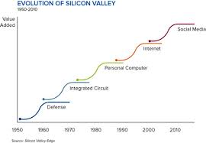
2. regional diversification based on relatedness

Slide 9
2. regional diversification based on relatedness
quantitative studies on related diversification
Hidalgo, Klinger, Barabasi and Hausmann (2007): how countries build a comparative advantage in export products that are new to the country
national capabilities condition which new industries will be feasible to develop
concept of product space: specifies the proximity between products based on the frequency of co-occurrence of products in countries’ export portfolios
countries develop new export products that are closely related in product space with existing export products
countries with higher related variety (i.e. positioned in the more dense parts of the product space) have more opportunities to diversify and sustain higher economic growth rates

Slide 10
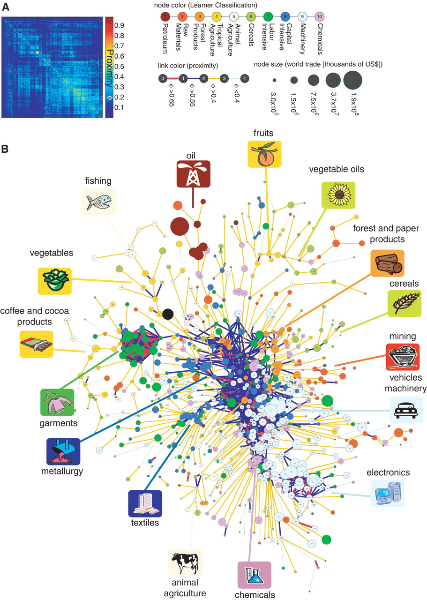
2. regional diversification based on relatedness

Slide 11
2. regional diversification based on relatedness
Neffke, Henning and Boschma (2011): industrial diversification in 70 Swedish regions 1969-2002
regional capabilities condition which new industries will be feasible to develop
concept of product relatedness: specifies technological relatedness between products based on the frequency of co-occurrence of products in the product portfolios of plants: economies of scope
Sweden: product data at the plant level for the period 1969-2002: product data assigned to standard industry codes (a total of 174 6-digit industries)
we calculated the average degree of technological relatedness between each pair of industries in the period 1969-2002, controlling for profitability and size of industries

Slide 12
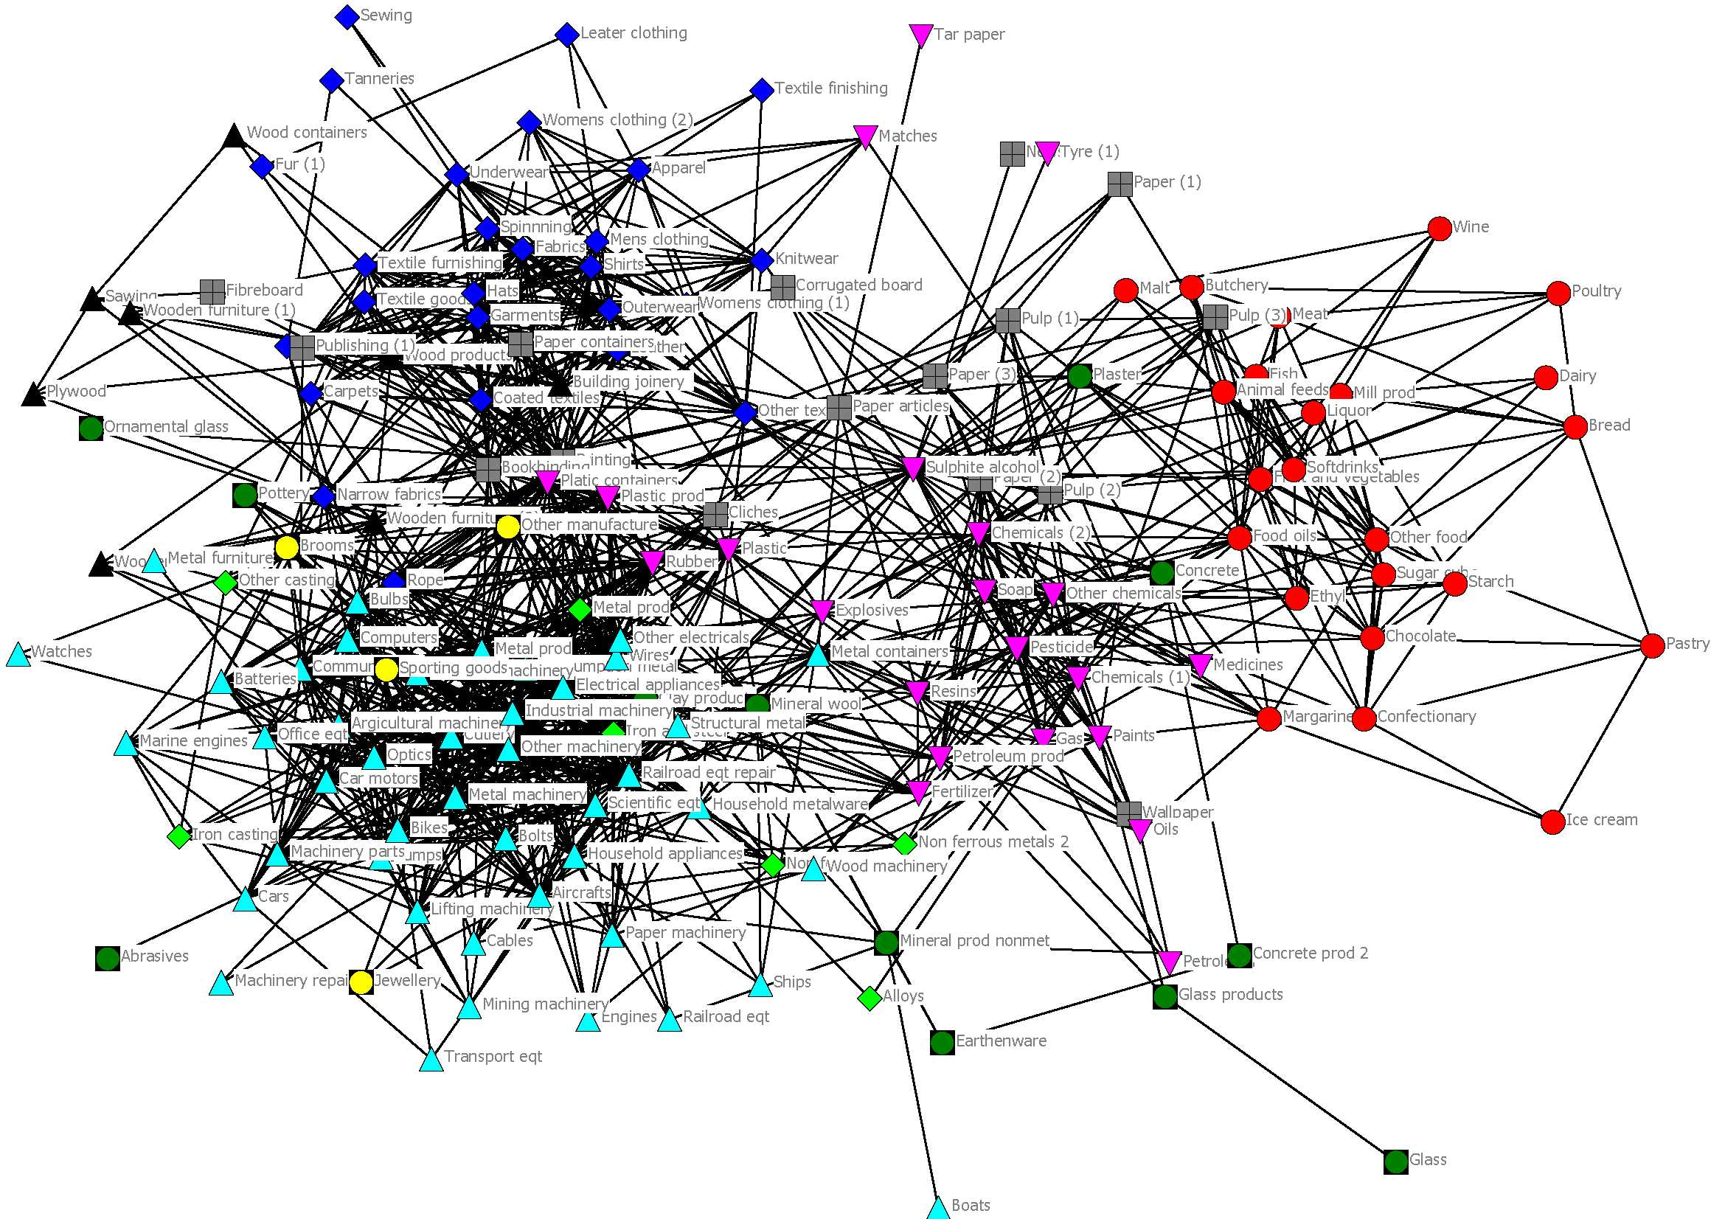
2. regional diversification based on relatedness

Slide 13
2. regional diversification based on relatedness
to determine whether entries and exits of industries in a region are affected by technological relatedness with other industries in the region, we aggregated our data to 70 Swedish regions
we developed an indicator to determine how close an industry is to all other industries in a region: technological closeness: the number of industries in a region that an industry is technologically related to above a certain threshold
we estimated the entry probability of an industry in a region, and how that is affected by the closeness of the new industry to a region’s portfolio
industries that are technologically related to pre-existing sectors in a region had a higher probability to enter the region: 2,766 events of an industry entering a region
this finding on industrial diversification has been replicated in many follow-up studies (Boschma et al. 2013; Essletzbichler 2013; Muneepeerakul et al. 2013; He and Rigby 2015)

Slide 14
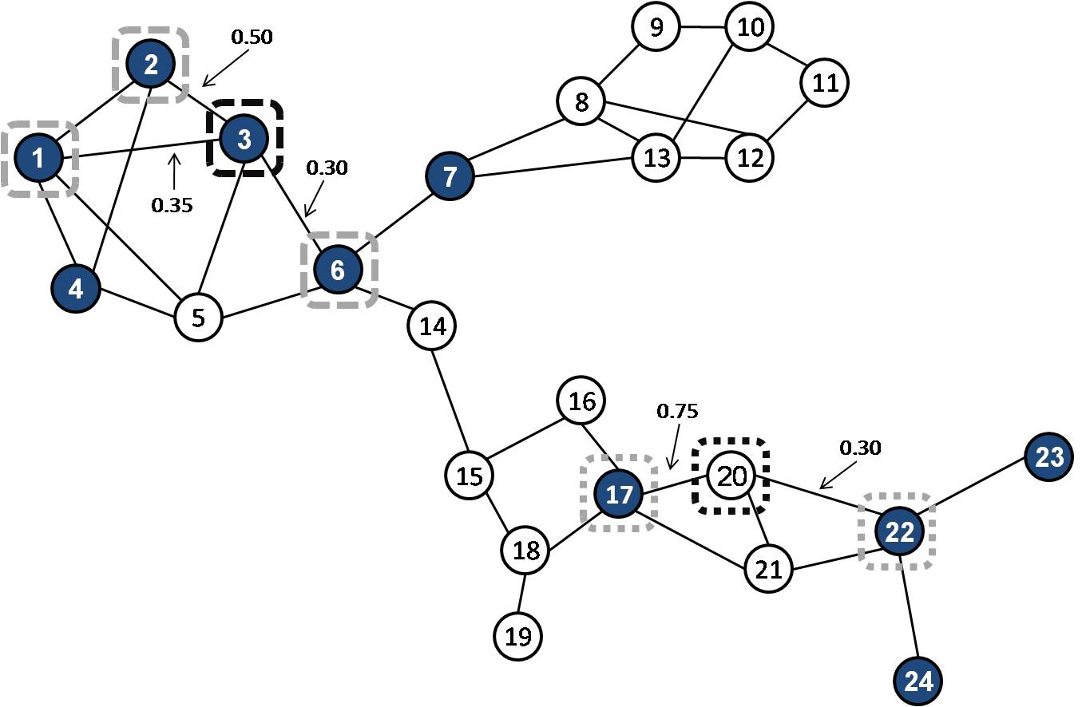
2. regional diversification based on relatedness

Slide 15
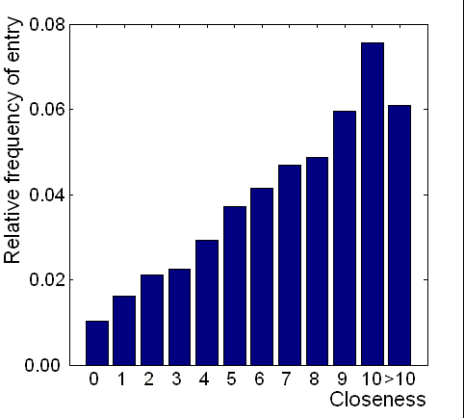
2. regional diversification based on relatedness

Slide 16
2. regional diversification based on relatedness
Rigby (2013): technological diversification in US metropolitan areas 1975-2005
regional capabilities condition which new technologies will be feasible to develop
concept of technological relatedness: specifies relatedness between knowledge domains based on the frequency of co-occurrence of technology classes on patent documents
technologies that are related to pre-existing technologies in a region had a higher probability to enter the region
this finding on technological diversification has been replicated for all technologies (Balland et al. 2014), for specific technologies (Heimeriks et al. 2014; Kogler et al. 2014), including clean technologies (Tanner 2014; Van den Berge and Weterings 2014)

Slide 17
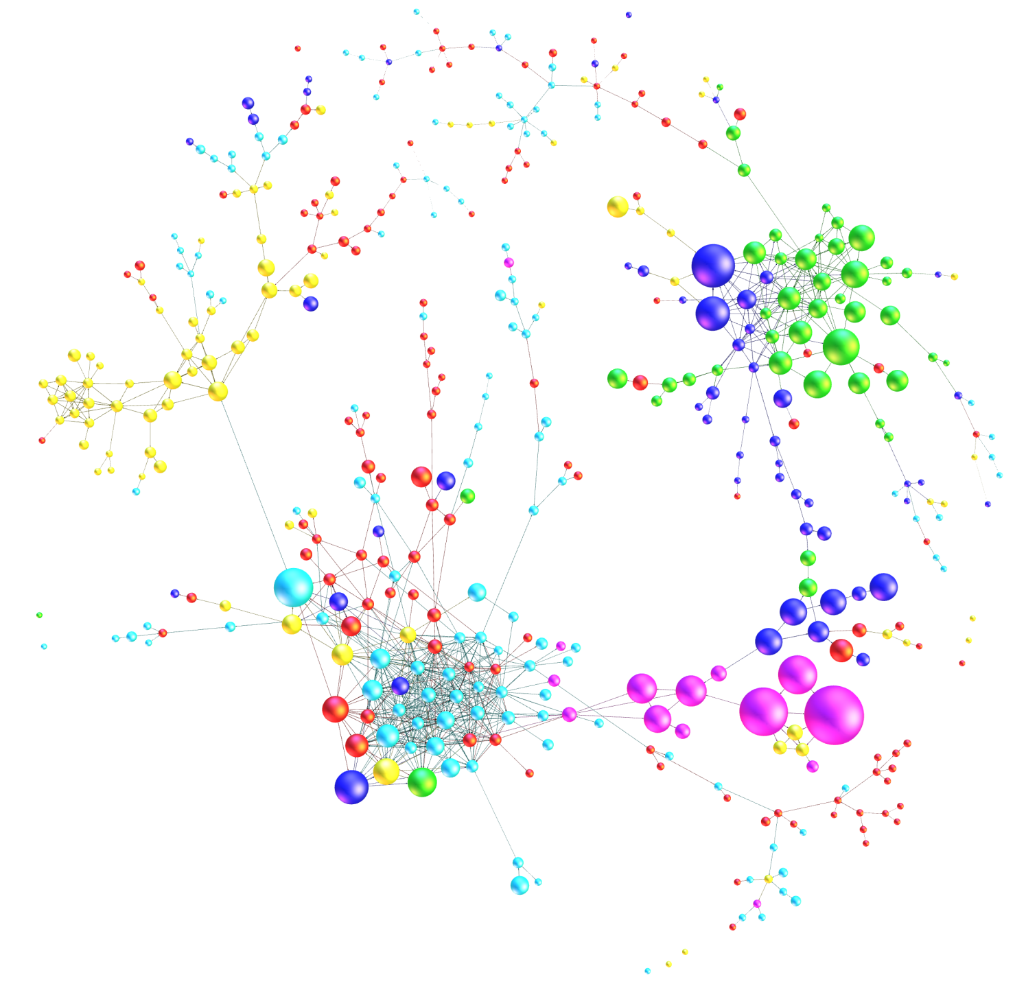
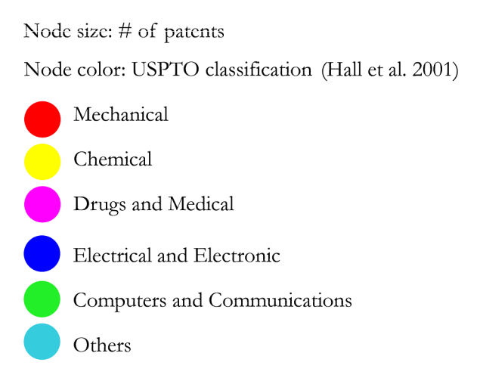
2. regional diversification based on relatedness

Slide 18
2. regional diversification based on relatedness
effect of relatedness on diversification may also vary between different regional institutional contexts: almost complete absent in the quantitative literature on regional diversification so far
institutional context (labor relations, corporate governance relations, inter-firm collaboration) might also have an impact on the intensity and direction of regional diversification:Varieties of Capitalism literature (Hall and Soskice)
Boschma and Capone (2015): whether countries gain comparative advantage in new sectors that are far or close from their current industrial structure depends on the type of national institutions

Slide 19
2. regional diversification based on relatedness
liberal market economies have institutions that favor diversification in more unrelated activities: weaker effect of relatedness due to more mobile and switchable assets that can be deployed to alternative uses
coordinated market economies have institutions that favor diversification in more related activities: stronger effect of relatedness due to more specific and committed assets
no systematic study yet exists that assesses the impact of regional institutions on the intensity and nature of regional diversification

Slide 20
3. entrepreneurship: spatial evolution of an industry
entrepreneurship might be a crucial driver behind regional branching: new industries do not start from scratch: relatedness is crucial
in the industrial dynamics literature (Klepper 2007), related spinoffs and diversifiers make the difference in the formative stage of a new industry in a region: higher survival rates
empirical study on the spatial evolution of British automobile sector 1895-1968 (Boschma and Wenting 2007)
longitudinal data on firm population dynamics: entries, exits and pre-entry background of entrepreneurs

Slide 21
3. entrepreneurship: spatial evolution of an industry

Slide 22
3. entrepreneurship: spatial evolution of an industry
hazard model to explain survival or hazard rates of automobile firms: dependent variable is the age of entrants
experienced entrepreneurs with relevant knowledge from related industries like engineering, cycle and coach making were crucial in first stage of the industry lifecycle: experienced entrepreneurs have a higher survival rate, in comparison to other types of entrepreneurs
regions with these related industries had a higher probability to develop the new automobile industry: positive effect of survival: evidence of regional branching at the micro-scale
localization economies had a negative impact on survival, possibly due to strong local competition (which is in contrast to the cluster literature that claims the opposite)

Slide 23
3. entrepreneurship: spatial evolution of an industry

Slide 24
3. entrepreneurship: spatial evolution of an industry
which mechanisms (like spinoffs and labor mobility) through which related activities interact: focus on flows from (related and unrelated) industries to new industries
micro-perspective should go beyond firms: institutional entrepreneurs: how local agents engage in collective action to mobilize resources to create new or adapt existing institutions, and to confront vested interests (Garud et al. 2007; Battilana et al. 2009; Sotarauta and Pulkkinen 2011)
no focus on institutional change in diversification literature: co-evolution of industries and institutions (Nelson 1994, Murmann 2004): why regions differ in their ability to induce institutional change?
role of successful return migrants (Saxenian): induce institutional change in their home regions, as they have immediate access to the ones in power
relatedness literature tends to be supply-driven: how about role of advanced demand from various actors, including government?

Slide 25
Thank you for your attention!

