Slide 1


Technological collaboration
and innovation production:
Does geography and relatedness matter?
Rosina Moreno
AQR-IREA Research Group. University of Barcelona

Slide 2

Motivation
The production of ideas, knowledge and innovations drives the economic development of countries and nations (Jones, 1995; Anghion and Howitt, 1998)
  Endogenous growth models: knowledge is a public good, non-rival and non-excludable, and resulting knowledge spillovers are the engine of increasing returns to scale and sustained economic growth (Romer, 1986, 1990; Lucas, 1988)
Geography of innovation:
  Tacitness of knowledge: relevant knowledge is highly contextual and hard to articulate
  Knowledge is better diffused through frequent interactions: public and local
  Incentives for agents and firms to cluster in space

Slide 3
Motivation
Localized knowledge spillovers became the cornerstone of the geography of innovation literature during the 1990s (Jaffe, 1986; Audretsch and Feldman, 1996,2004)
  Co-location implies ceaseless inflows of information
Excessively close actors may have little to exchange
  Interacting only with physically close agents may prevent individuals to access valuable and non-redundant pools of ideas.
  Interacting only with agents in the same technological sector will provide with redundant information: regional ‘lock-in’ (Boschma and Frenken, 2009)

Slide 4
Motivation
We depart from the idea close actors may have little to exchange after certain amount of interactions. Firms need to turn to external sources of ideas (Rosenkopf and Almeida, 2003; Boschma and Frenken, 2009) to overcome potential situations of regional entropic death, lock-in or overembeddedness (Boschma, 2005; Camagni, 1991; Uzzi, 1996)
    Firms look for external sources of knowledge spanning the boundaries of the firm, region, country
In some instances, it is not enough by being there to receive knowledge flows : Rather, knowledge flows follows specific transmission channels, based on market interactions (requires conscious efforts, they are not free and may span the boundaries of a region)
    Technological collaborations shape the geography of innovation production in Europe (Miguélez and Moreno, 2013a, 2013b; 2015).

Slide 5
OBJECTIVES
First research: to what extent the benefits of collaboration agreements differ across the geography? Firm level analysis.
Second research: the level of relatedness between the local knowledge economy and the knowledge coming from other regions/countries: Regional level analysis although with information from patents.
  Tenet: Two proximate actors may have little knowledge to exchange, whilst innovation production usually requires dissimilar, complementary knowledge to be amalgamated (Boschma and Frenken, 2009)

Slide 6


Does absorptive capacity determine collaborative research returns to innovation? A geographical dimension
Erika R. Badillo
Rosina Moreno

Slide 7
Motivation
Firms need to innovate continuously and rapidly to survive in today’s competitive and global markets.
Knowledge diffusion between individuals and firms is critical for innovation and growth (Grossman and Helpman, 1991; Lucas, 1988; Romer, 1986, 1990).
Knowledge is known to diffuse through a variety of mechanisms (Döring and Schnellenbach, 2006), among which research collaboration is considered essential.
Firms are expanding technology interaction with different and increasingly geographically dispersed actors.

Slide 8
Motivation
Percentage of cooperative firms by type of alliance
 | 2005 | 2007 | 2009 | 2011
% Cooperative firms over innovative firms | 35.8 | 33.9 | 35.3 | 37.8
Geographical areas of alliances (% of each category over cooperative firms)
National exclusively | 67.76 | 64.20 | 62.53 | 58.18
International exclusively | 5.12 | 5.25 | 4.32 | 4.46
National&International | 27.12 | 30.54 | 33.15 | 37.36
Total | 100 | 100 | 100 | 100
International alliances
European exclusively | 79.86 | 71.09 | 75.49 | 69.57
US exclusively | 3.60 | 7.03 | 6.86 | 6.52
Asian/Others exclusively | 7.19 | 6.25 | 9.80 | 11.96
Multiple foreign areas (at least two) | 9.35 | 15.63 | 7.84 | 11.96
Total | 100 | 100 | 100 | 100

Slide 9
Relevant questions
To what extent do the benefits of research collaboration differ across different dimensions of the geography?
Does collaboration with partners in simultaneous diverse geographical areas obtain an extra benefit?
Does absorptive capacity determine collaborative research returns to innovation differently according to the geography?

Slide 10
Hypothesis (1)
Collaboration with foreign partners
  can produce complementary knowledge that is in short supply in the firm’s home country (Miotti and Sachwald, 2003; Lavie and Miller, 2008; van Beers and Zand, 2014)
  in remote areas can provide with less redundant pieces of knowledge (Duysters and Lokshin, 2011)
Previous studies: innovation performance is positively influenced by international R&D cooperation, but unaffected or less affected by national cooperation (Miotti and Sachwald, 2003; Cincera et al., 2003; Lööf, 2009; Arvanitis and Bolli, 2013)
H1: We expect collaborative research with non-European partners to have higher impact on the firm’s innovative performance than national or European research collaborations.

Slide 11
Hypothesis (2)
Diversity of partners (suppliers, clients, competitors,….) allows for a wider amount and variety of knowledge than alliances with just one partnership (Becker and Dietz, 2004; Laursen and Salter, 2004; Nieto and Santamaría, 2007)
Additional alliances with the same type of partner would provide only redundant information (Hoang and Rothaermel, 2005)
H2: Collaboration with partners from diverse geographical areas should substantially boosts innovation more than from just one area (opportunity to choose between different technological paths and apply it).

Slide 12
Hypothesis (3)
The differential impact of external knowledge flows depends mainly on firms’ absorptive capacity (Cohen and Levinthal, 1990)
Those firms with higher levels of absorptive capacity can manage external knowledge flows more efficiently (increase its ability to understand and assimilate knowledge from external sources) and therefore, stimulate innovative outcomes (Escribano et al., 2009)
H3: Those firms with large absorptive capacity obtain an innovation premium from alliances with other partners. This premium is higher in the case of international alliances than for national ones

Slide 13

Estimation model
A two-stage selection model, using the Wooldridge’s (1995) consistent estimator for panel data with sample selection.
(i) Selection equation indicating whether or not the firm was innovative:
1[.] is an indicator function that takes the value 1 if the firm engages in innovation activities and 0 otherwise.
Determinants: firm size (and its squared); market share; belonging to a group; factors perceived as barriers to innovation activities; industry dummies
$$d_{it}=1\left[z_{it}γ+ η_{i}+ u_{it}>0\right],$$

Slide 14
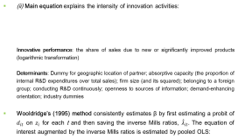
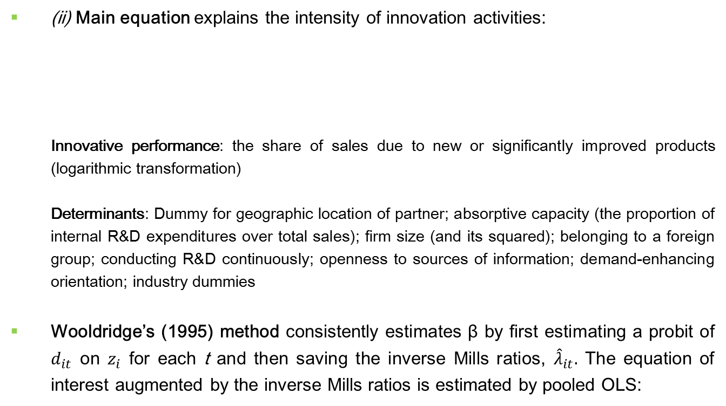
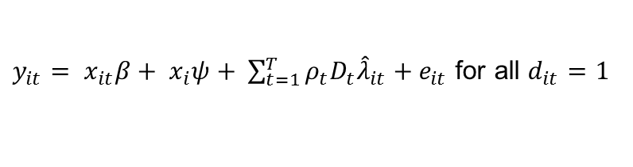

Estimation model
(ii) Main equation explains the intensity of innovation activities:
Innovative performance: the share of sales due to new or significantly improved products (logarithmic transformation)
Determinants: Dummy for geographic location of partner; absorptive capacity (the proportion of internal R&D expenditures over total sales); firm size (and its squared); belonging to a foreign group; conducting R&D continuously; openness to sources of information; demand-enhancing orientation; industry dummies
Wooldridge’s (1995) method consistently estimates β by first estimating a probit of $d_{it}$ on $z_{i}$ for each t and then saving the inverse Mills ratios, ${\hat{λ}}_{it}.$ The equation of interest augmented by the inverse Mills ratios is estimated by pooled OLS:
$$y_{it}= \left\{\begin{aligned}x_{it}β+ α_{i}+ ε_{it} if d_{it}=1 \\ 0 if d_{it}=0, \end{aligned}\right.$$
$y_{it}= x_{it}β+ x_{i}ψ+ \sum_{t=1}^{T}{ρ_{t}D_{t}{\hat{λ}}_{it}}+e_{it}$ for all $d_{it}=1$

Slide 15
Data and descriptive statistics
Data from the Technological Innovation Panel (PITEC) built by INE (National Institute of Statistics) from the Spanish Innovation Survey.
Period 2004-2011 (firms which are observed in year t-2 and t)
Manufacturing and services
70,182 observations on 10,012 firms.

Slide 16
Data and descriptive statistics
Percentage of cooperative firms by type of alliance
 | 2005 | 2007 | 2009 | 2011
% Cooperative firms over innovative firms | 35.8 | 33.9 | 35.3 | 37.8
Geographical areas of alliances (% of each category over cooperative firms)
National exclusively | 67.76 | 64.20 | 62.53 | 58.18
International exclusively | 5.12 | 5.25 | 4.32 | 4.46
National&International | 27.12 | 30.54 | 33.15 | 37.36
Total | 100 | 100 | 100 | 100
International alliances
European exclusively | 79.86 | 71.09 | 75.49 | 69.57
US exclusively | 3.60 | 7.03 | 6.86 | 6.52
Asian/Others exclusively | 7.19 | 6.25 | 9.80 | 11.96
Multiple foreign areas (at least two) | 9.35 | 15.63 | 7.84 | 11.96
Total | 100 | 100 | 100 | 100
On average, more than 60% of collaborative firms maintain research alliances only with national partners with a decreasing pattern from 2005.
The second most common type of alliance is collaborations with both national and international partners which appears to be increasing over time.
Within international alliances, research collaboration with European partners is the most intensive one although with a slightly decreasing trend. Contrarily, the proportion of alliances with partners in more distant geographical areas, although of lower magnitude than in the European case, tend to increase along the period.

Slide 17
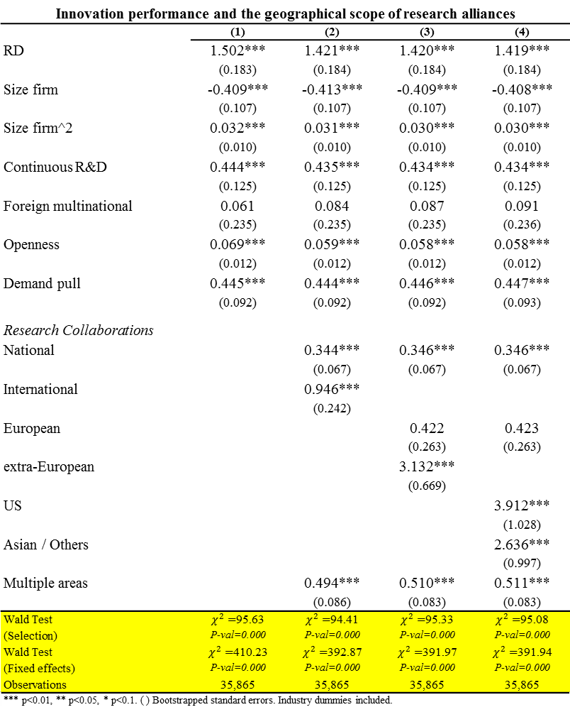
Results
Innovation performance and the geographical scope of research alliances
 | (1) | (2) | (3) | (4)
RD | 1.502*** | 1.421*** | 1.420*** | 1.419***
 | (0.183) | (0.184) | (0.184) | (0.184)
Size firm | -0.409*** | -0.413*** | -0.409*** | -0.408***
 | (0.107) | (0.107) | (0.107) | (0.107)
Size firm^2 | 0.032*** | 0.031*** | 0.030*** | 0.030***
 | (0.010) | (0.010) | (0.010) | (0.010)
Continuous R&D | 0.444*** | 0.435*** | 0.434*** | 0.434***
 | (0.125) | (0.125) | (0.125) | (0.125)
Foreign multinational | 0.061 | 0.084 | 0.087 | 0.091
 | (0.235) | (0.235) | (0.235) | (0.236)
Openness | 0.069*** | 0.059*** | 0.058*** | 0.058***
 | (0.012) | (0.012) | (0.012) | (0.012)
Demand pull | 0.445*** | 0.444*** | 0.446*** | 0.447***
 | (0.092) | (0.092) | (0.092) | (0.093)
Research Collaborations
National |  | 0.344*** | 0.346*** | 0.346***
 |  | (0.067) | (0.067) | (0.067)
International |  | 0.946***
 |  | (0.242)
European |  |  | 0.422 | 0.423
 |  |  | (0.263) | (0.263)
extra-European |  |  | 3.132***
 |  |  | (0.669)
US |  |  |  | 3.912***
 |  |  |  | (1.028)
Asian / Others |  |  |  | 2.636***
 |  |  |  | (0.997)
Multiple areas |  | 0.494*** | 0.510*** | 0.511***
 |  | (0.086) | (0.083) | (0.083)
Wald Test | $χ_{}^{2}=$95.63 | $χ_{}^{2}=$94.41 | $χ_{}^{2}=$95.33 | $χ_{}^{2}=$95.08
(Selection) | P-val=0.000 | P-val=0.000 | P-val=0.000 | P-val=0.000
Wald Test | $χ_{}^{2}=$410.23 | $χ_{}^{2}=$392.87 | $χ_{}^{2}=$391.97 | $χ_{}^{2}=$391.94
(Fixed effects) | P-val=0.000 | P-val=0.000 | P-val=0.000 | P-val=0.000
Observations | 35,865 | 35,865 | 35,865 | 35,865
*** p<0.01, ** p<0.05, * p<0.1. ( ) Bootstrapped standard errors. Industry dummies included.
Notes:
THESE ARE the results for different specifications of our mail model of innovation performance.
Through all the results Wald tests suggest the presence of correlated individual effects and the necessity of correcting for sample selection bias.

Slide 18
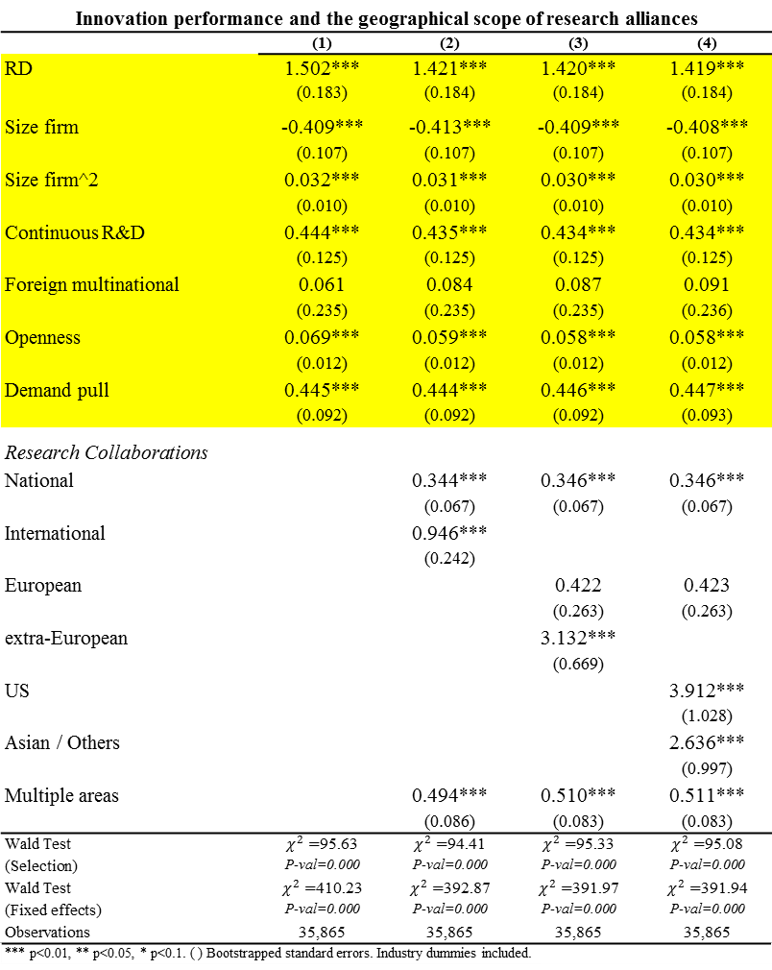
Results
Innovation performance and the geographical scope of research alliances
 | (1) | (2) | (3) | (4)
RD | 1.502*** | 1.421*** | 1.420*** | 1.419***
 | (0.183) | (0.184) | (0.184) | (0.184)
Size firm | -0.409*** | -0.413*** | -0.409*** | -0.408***
 | (0.107) | (0.107) | (0.107) | (0.107)
Size firm^2 | 0.032*** | 0.031*** | 0.030*** | 0.030***
 | (0.010) | (0.010) | (0.010) | (0.010)
Continuous R&D | 0.444*** | 0.435*** | 0.434*** | 0.434***
 | (0.125) | (0.125) | (0.125) | (0.125)
Foreign multinational | 0.061 | 0.084 | 0.087 | 0.091
 | (0.235) | (0.235) | (0.235) | (0.236)
Openness | 0.069*** | 0.059*** | 0.058*** | 0.058***
 | (0.012) | (0.012) | (0.012) | (0.012)
Demand pull | 0.445*** | 0.444*** | 0.446*** | 0.447***
 | (0.092) | (0.092) | (0.092) | (0.093)
Research Collaborations
National |  | 0.344*** | 0.346*** | 0.346***
 |  | (0.067) | (0.067) | (0.067)
International |  | 0.946***
 |  | (0.242)
European |  |  | 0.422 | 0.423
 |  |  | (0.263) | (0.263)
extra-European |  |  | 3.132***
 |  |  | (0.669)
US |  |  |  | 3.912***
 |  |  |  | (1.028)
Asian / Others |  |  |  | 2.636***
 |  |  |  | (0.997)
Multiple areas |  | 0.494*** | 0.510*** | 0.511***
 |  | (0.086) | (0.083) | (0.083)
Wald Test | $χ_{}^{2}=$95.63 | $χ_{}^{2}=$94.41 | $χ_{}^{2}=$95.33 | $χ_{}^{2}=$95.08
(Selection) | P-val=0.000 | P-val=0.000 | P-val=0.000 | P-val=0.000
Wald Test | $χ_{}^{2}=$410.23 | $χ_{}^{2}=$392.87 | $χ_{}^{2}=$391.97 | $χ_{}^{2}=$391.94
(Fixed effects) | P-val=0.000 | P-val=0.000 | P-val=0.000 | P-val=0.000
Observations | 35,865 | 35,865 | 35,865 | 35,865
*** p<0.01, ** p<0.05, * p<0.1. ( ) Bootstrapped standard errors. Industry dummies included.
Notes:
Regarding control variables, the results are robust through all our estimates and theses results are in line with previous literature.
We will focus on collaboration variables

Slide 19
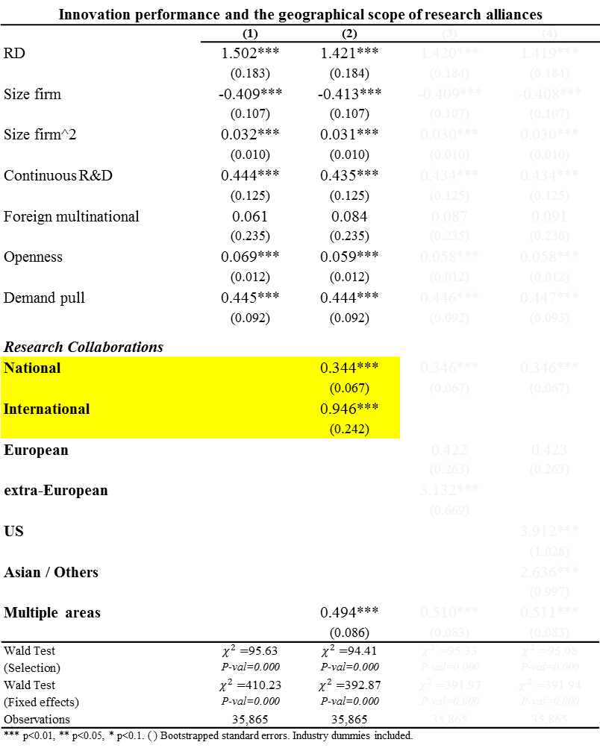
Results
Innovation performance and the geographical scope of research alliances
 | (1) | (2) | (3) | (4)
RD | 1.502*** | 1.421*** | 1.420*** | 1.419***
 | (0.183) | (0.184) | (0.184) | (0.184)
Size firm | -0.409*** | -0.413*** | -0.409*** | -0.408***
 | (0.107) | (0.107) | (0.107) | (0.107)
Size firm^2 | 0.032*** | 0.031*** | 0.030*** | 0.030***
 | (0.010) | (0.010) | (0.010) | (0.010)
Continuous R&D | 0.444*** | 0.435*** | 0.434*** | 0.434***
 | (0.125) | (0.125) | (0.125) | (0.125)
Foreign multinational | 0.061 | 0.084 | 0.087 | 0.091
 | (0.235) | (0.235) | (0.235) | (0.236)
Openness | 0.069*** | 0.059*** | 0.058*** | 0.058***
 | (0.012) | (0.012) | (0.012) | (0.012)
Demand pull | 0.445*** | 0.444*** | 0.446*** | 0.447***
 | (0.092) | (0.092) | (0.092) | (0.093)
Research Collaborations
National |  | 0.344*** | 0.346*** | 0.346***
 |  | (0.067) | (0.067) | (0.067)
International |  | 0.946***
 |  | (0.242)
European |  |  | 0.422 | 0.423
 |  |  | (0.263) | (0.263)
extra-European |  |  | 3.132***
 |  |  | (0.669)
US |  |  |  | 3.912***
 |  |  |  | (1.028)
Asian / Others |  |  |  | 2.636***
 |  |  |  | (0.997)
Multiple areas |  | 0.494*** | 0.510*** | 0.511***
 |  | (0.086) | (0.083) | (0.083)
Wald Test | $χ_{}^{2}=$95.63 | $χ_{}^{2}=$94.41 | $χ_{}^{2}=$95.33 | $χ_{}^{2}=$95.08
(Selection) | P-val=0.000 | P-val=0.000 | P-val=0.000 | P-val=0.000
Wald Test | $χ_{}^{2}=$410.23 | $χ_{}^{2}=$392.87 | $χ_{}^{2}=$391.97 | $χ_{}^{2}=$391.94
(Fixed effects) | P-val=0.000 | P-val=0.000 | P-val=0.000 | P-val=0.000
Observations | 35,865 | 35,865 | 35,865 | 35,865
*** p<0.01, ** p<0.05, * p<0.1. ( ) Bootstrapped standard errors. Industry dummies included.
Firms maintaining research collaborations with partners abroad increase the share of innovative sales more than those that collaborate only with national partners.
H1. Knowledge that comes from distant geographical areas can provide with less redundant pieces of knowledge, which would allow enhancing innovation capabilities.
Notes:
THEREFORE, These results support our first hypothesis, which is in accordance with the idea that …
… provide with less redundant information, which would allow …

Slide 20
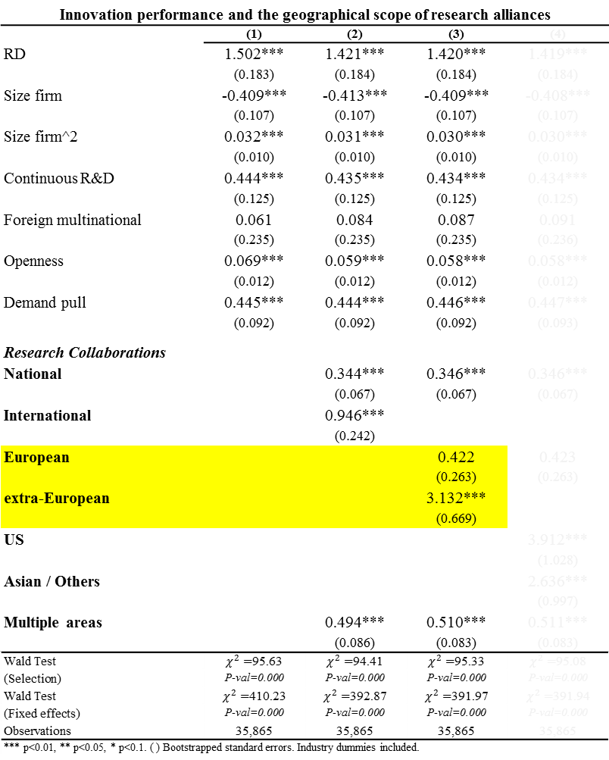
Results
Innovation performance and the geographical scope of research alliances
 | (1) | (2) | (3) | (4)
RD | 1.502*** | 1.421*** | 1.420*** | 1.419***
 | (0.183) | (0.184) | (0.184) | (0.184)
Size firm | -0.409*** | -0.413*** | -0.409*** | -0.408***
 | (0.107) | (0.107) | (0.107) | (0.107)
Size firm^2 | 0.032*** | 0.031*** | 0.030*** | 0.030***
 | (0.010) | (0.010) | (0.010) | (0.010)
Continuous R&D | 0.444*** | 0.435*** | 0.434*** | 0.434***
 | (0.125) | (0.125) | (0.125) | (0.125)
Foreign multinational | 0.061 | 0.084 | 0.087 | 0.091
 | (0.235) | (0.235) | (0.235) | (0.236)
Openness | 0.069*** | 0.059*** | 0.058*** | 0.058***
 | (0.012) | (0.012) | (0.012) | (0.012)
Demand pull | 0.445*** | 0.444*** | 0.446*** | 0.447***
 | (0.092) | (0.092) | (0.092) | (0.093)
Research Collaborations
National |  | 0.344*** | 0.346*** | 0.346***
 |  | (0.067) | (0.067) | (0.067)
International |  | 0.946***
 |  | (0.242)
European |  |  | 0.422 | 0.423
 |  |  | (0.263) | (0.263)
extra-European |  |  | 3.132***
 |  |  | (0.669)
US |  |  |  | 3.912***
 |  |  |  | (1.028)
Asian / Others |  |  |  | 2.636***
 |  |  |  | (0.997)
Multiple areas |  | 0.494*** | 0.510*** | 0.511***
 |  | (0.086) | (0.083) | (0.083)
Wald Test | $χ_{}^{2}=$95.63 | $χ_{}^{2}=$94.41 | $χ_{}^{2}=$95.33 | $χ_{}^{2}=$95.08
(Selection) | P-val=0.000 | P-val=0.000 | P-val=0.000 | P-val=0.000
Wald Test | $χ_{}^{2}=$410.23 | $χ_{}^{2}=$392.87 | $χ_{}^{2}=$391.97 | $χ_{}^{2}=$391.94
(Fixed effects) | P-val=0.000 | P-val=0.000 | P-val=0.000 | P-val=0.000
Observations | 35,865 | 35,865 | 35,865 | 35,865
*** p<0.01, ** p<0.05, * p<0.1. ( ) Bootstrapped standard errors. Industry dummies included.
Collaborations with European partners do not promote innovation sales, whereas for extra-European is highly significant
The benefits and costs of cooperating in international contexts may vary according to the level of internationalization (Lavie and Miller, 2008)
The benefits with Europeans do not surpass the cost of cooperating internationally
Notes:
When we disaggregate the variable of international research alliances distinguishing between European and extra-European,
we obtain that…
… whereas, when such collaborations are carried out with partners in very distant geographical areas the impact on innovation performance is found to be (positive and) highly significant.

Slide 21
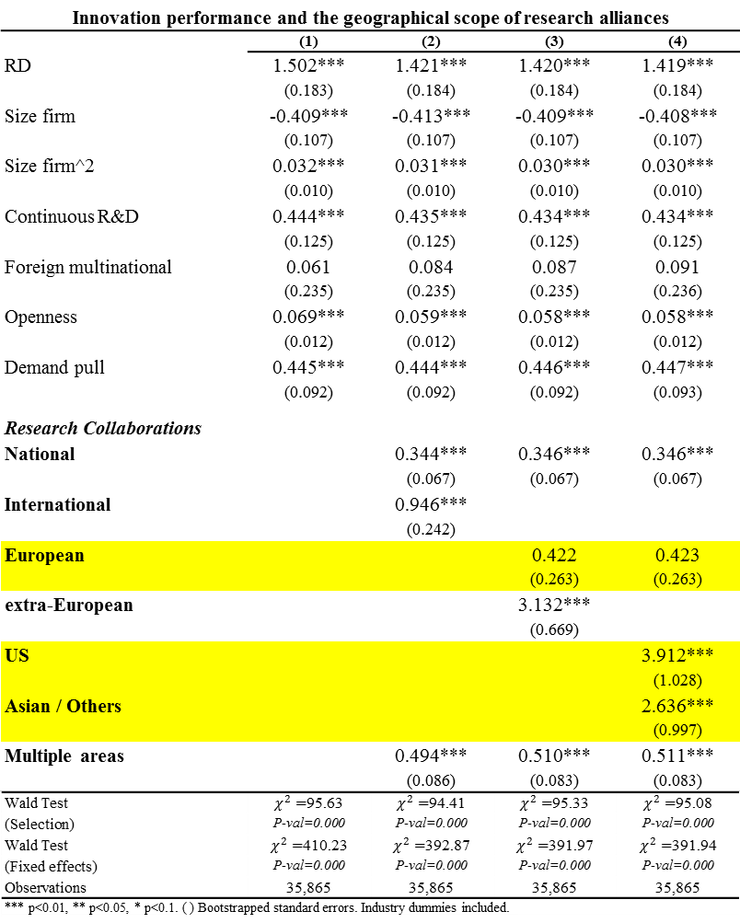
Results
Innovation performance and the geographical scope of research alliances
 | (1) | (2) | (3) | (4)
RD | 1.502*** | 1.421*** | 1.420*** | 1.419***
 | (0.183) | (0.184) | (0.184) | (0.184)
Size firm | -0.409*** | -0.413*** | -0.409*** | -0.408***
 | (0.107) | (0.107) | (0.107) | (0.107)
Size firm^2 | 0.032*** | 0.031*** | 0.030*** | 0.030***
 | (0.010) | (0.010) | (0.010) | (0.010)
Continuous R&D | 0.444*** | 0.435*** | 0.434*** | 0.434***
 | (0.125) | (0.125) | (0.125) | (0.125)
Foreign multinational | 0.061 | 0.084 | 0.087 | 0.091
 | (0.235) | (0.235) | (0.235) | (0.236)
Openness | 0.069*** | 0.059*** | 0.058*** | 0.058***
 | (0.012) | (0.012) | (0.012) | (0.012)
Demand pull | 0.445*** | 0.444*** | 0.446*** | 0.447***
 | (0.092) | (0.092) | (0.092) | (0.093)
Research Collaborations
National |  | 0.344*** | 0.346*** | 0.346***
 |  | (0.067) | (0.067) | (0.067)
International |  | 0.946***
 |  | (0.242)
European |  |  | 0.422 | 0.423
 |  |  | (0.263) | (0.263)
extra-European |  |  | 3.132***
 |  |  | (0.669)
US |  |  |  | 3.912***
 |  |  |  | (1.028)
Asian / Others |  |  |  | 2.636***
 |  |  |  | (0.997)
Multiple areas |  | 0.494*** | 0.510*** | 0.511***
 |  | (0.086) | (0.083) | (0.083)
Wald Test | $χ_{}^{2}=$95.63 | $χ_{}^{2}=$94.41 | $χ_{}^{2}=$95.33 | $χ_{}^{2}=$95.08
(Selection) | P-val=0.000 | P-val=0.000 | P-val=0.000 | P-val=0.000
Wald Test | $χ_{}^{2}=$410.23 | $χ_{}^{2}=$392.87 | $χ_{}^{2}=$391.97 | $χ_{}^{2}=$391.94
(Fixed effects) | P-val=0.000 | P-val=0.000 | P-val=0.000 | P-val=0.000
Observations | 35,865 | 35,865 | 35,865 | 35,865
*** p<0.01, ** p<0.05, * p<0.1. ( ) Bootstrapped standard errors. Industry dummies included.
Among the extra-European cooperative agreements, it is not only those with US but also with Asian partners, that positively influence the innovative performance of Spanish firms.
Notes:
AND More disaggregated in Column 4, we observe that Among the extra-European agreements, both US and Asian alliances positively influence the innovation performance of Spanish firms

Slide 22
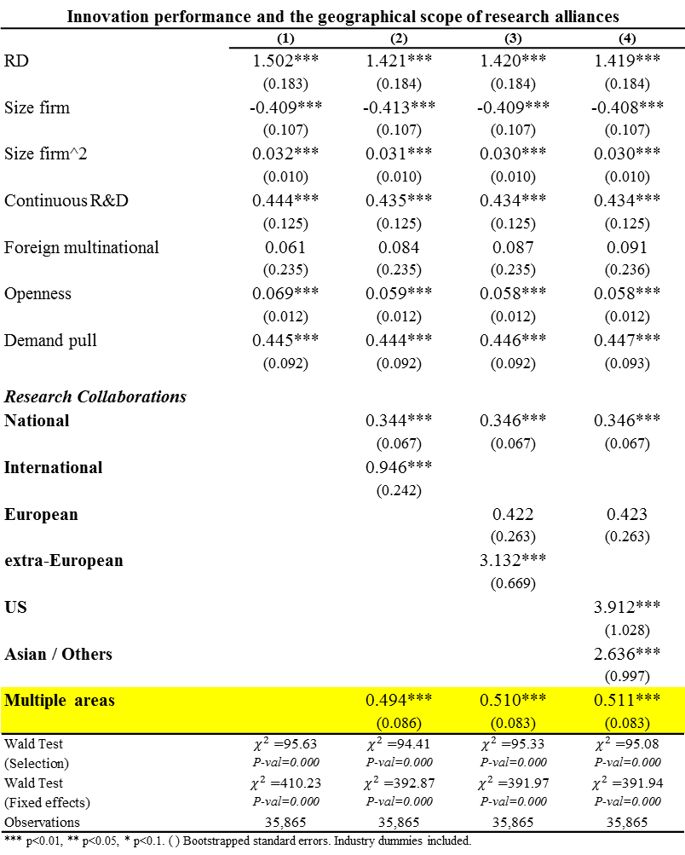
Results
Innovation performance and the geographical scope of research alliances
 | (1) | (2) | (3) | (4)
RD | 1.502*** | 1.421*** | 1.420*** | 1.419***
 | (0.183) | (0.184) | (0.184) | (0.184)
Size firm | -0.409*** | -0.413*** | -0.409*** | -0.408***
 | (0.107) | (0.107) | (0.107) | (0.107)
Size firm^2 | 0.032*** | 0.031*** | 0.030*** | 0.030***
 | (0.010) | (0.010) | (0.010) | (0.010)
Continuous R&D | 0.444*** | 0.435*** | 0.434*** | 0.434***
 | (0.125) | (0.125) | (0.125) | (0.125)
Foreign multinational | 0.061 | 0.084 | 0.087 | 0.091
 | (0.235) | (0.235) | (0.235) | (0.236)
Openness | 0.069*** | 0.059*** | 0.058*** | 0.058***
 | (0.012) | (0.012) | (0.012) | (0.012)
Demand pull | 0.445*** | 0.444*** | 0.446*** | 0.447***
 | (0.092) | (0.092) | (0.092) | (0.093)
Research Collaborations
National |  | 0.344*** | 0.346*** | 0.346***
 |  | (0.067) | (0.067) | (0.067)
International |  | 0.946***
 |  | (0.242)
European |  |  | 0.422 | 0.423
 |  |  | (0.263) | (0.263)
extra-European |  |  | 3.132***
 |  |  | (0.669)
US |  |  |  | 3.912***
 |  |  |  | (1.028)
Asian / Others |  |  |  | 2.636***
 |  |  |  | (0.997)
Multiple areas |  | 0.494*** | 0.510*** | 0.511***
 |  | (0.086) | (0.083) | (0.083)
Wald Test | $χ_{}^{2}=$95.63 | $χ_{}^{2}=$94.41 | $χ_{}^{2}=$95.33 | $χ_{}^{2}=$95.08
(Selection) | P-val=0.000 | P-val=0.000 | P-val=0.000 | P-val=0.000
Wald Test | $χ_{}^{2}=$410.23 | $χ_{}^{2}=$392.87 | $χ_{}^{2}=$391.97 | $χ_{}^{2}=$391.94
(Fixed effects) | P-val=0.000 | P-val=0.000 | P-val=0.000 | P-val=0.000
Observations | 35,865 | 35,865 | 35,865 | 35,865
*** p<0.01, ** p<0.05, * p<0.1. ( ) Bootstrapped standard errors. Industry dummies included.
H2. Diversity of partnership only leads to better innovation performance than that of innovating firms cooperating exclusively with national or exclusively with European partners.
▶ Firms reach a point after which marginal costs of managing more complex and heterogeneous networks are higher than the expected benefits
Notes:
This may be explained because…
ALSO implies… (than the benefits obtain from collaboration with extra-European partners)

Slide 23
Results
Geographical dimension in research cooperation and absorptive capacity
 | (1) | (2) | (3)
RD | 0.796*** | 0.805*** | 0.805***
 | (0.287) | (0.288) | (0.287)
Research Collaborations
National | 0.303*** | 0.305*** | 0.305***
 | (0.070) | (0.070) | (0.071)
International | 0.773***
 | (0.245)
European |  | 0.278 | 0.279
 |  | (0.269) | (0.268)
Extra-European |  | 2.876***
 |  | (0.723)
US |  |  | 3.551***
 |  |  | (1.126)
Asian/Others |  |  | 2.577**
 |  |  | (1.219)
Multiple areas | 0.399*** | 0.416*** | 0.417***
 | (0.088) | (0.087) | (0.087)
National * RD | 0.753* | 0.750* | 0.750*
 | (0.396) | (0.396) | (0.396)
International * RD | 3.200***
 | (1.042)
European * RD |  | 2.908* | 2.907*
 |  | (1.568) | (1.569)
Extra-European * RD |  | 4.150
 |  | (5.138)
US * RD |  |  | 3.935
 |  |  | (6.744)
Asian/Others * RD |  |  | 1.231
 |  |  | (19.053)
Multiple areas * RD | 0.926*** | 0.924*** | 0.923***
 | (0.338) | (0.340) | (0.340)
*** p<0.01, ** p<0.05, * p<0.1. ( ) Bootstrapped standard errors. Control variables included.
H3. Those firms with large absorptive capacity obtain an innovation premium from alliances with other partners. This premium is higher in the case of international alliances than for national ones.
▶ Absorptive capacity gives firms the ability to understand and assimilate better the knowledge that comes from other national innovation systems.
Notes:
probably due to such…

Slide 24
Results
Geographical dimension in research cooperation and absorptive capacity
 | (1) | (2) | (3)
RD | 0.796*** | 0.805*** | 0.805***
 | (0.287) | (0.288) | (0.287)
Research Collaborations
National | 0.303*** | 0.305*** | 0.305***
 | (0.070) | (0.070) | (0.071)
International | 0.773***
 | (0.245)
European |  | 0.278 | 0.279
 |  | (0.269) | (0.268)
Extra-European |  | 2.876***
 |  | (0.723)
US |  |  | 3.551***
 |  |  | (1.126)
Asian/Others |  |  | 2.577**
 |  |  | (1.219)
Multiple areas | 0.399*** | 0.416*** | 0.417***
 | (0.088) | (0.087) | (0.087)
National * RD | 0.753* | 0.750* | 0.750*
 | (0.396) | (0.396) | (0.396)
International * RD | 3.200***
 | (1.042)
European * RD |  | 2.908* | 2.907*
 |  | (1.568) | (1.569)
Extra-European * RD |  | 4.150
 |  | (5.138)
US * RD |  |  | 3.935
 |  |  | (6.744)
Asian/Others * RD |  |  | 1.231
 |  |  | (19.053)
Multiple areas * RD | 0.926*** | 0.924*** | 0.923***
 | (0.338) | (0.340) | (0.340)
*** p<0.01, ** p<0.05, * p<0.1. ( ) Bootstrapped standard errors. Control variables included.
Firms cooperating with European partners have low capability to understand and exploit the knowledge and resources that can be provided by their partners
▶ an increase in this capacity make a difference.
Firms cooperating with extra-European partners already have high levels of absorptive capability to understand and exploit the non-redundant knowledge and resources ▶ an increase in this capacity does not make a difference.
Notes:
Interestingly enough, when we disaggregate the international area,
The effects of interaction terms are also positive and significant for the European case but they are not neither for the US or the rest of the countries (case)
There is not a clear explanation at first sight, but
When looking at the data of the share of R&D expenditures we found that the average value in the case of firms cooperating exclusively with European partner is much lower than in the case of firms cooperating, for instance, exclusively with American partners. The values are 4% vs 14% respectively
So, This leads us to think that…
probably because their low…
However, when the… (it seems that the barriers …)
Then,
On the contrary,… already have high absorptive capacity …
which allow them obtain
(…and obtain a significant and high innovative premium from such cooperation agreements, )
(SO THAT)

Slide 25
Conclusions
A pivotal element for generation of new knowledge lies in accessing external sources.
From policy perspective: not only R&D and human capital efforts but also connectivity . Smart specialization strategy
The promotion of distant ties embracing as many factors as possible is a plausible and beneficial policy option
Innovation policies which neglect the absorption capacity of firms and regions are incomplete.
Notes:
Absorptive capacity is a key factor to explain…

Slide 26
RELATEDNESS and EXTERNAL LINKAGES
FOR EUROPE’S REGIONAL INNOVATION
Ernest Miguélez*
Rosina Moreno⁺
* GREThA– Université de Bordeaux & AQR-IREA & CReAM
+ AQR-IREA

Slide 27
Motivation
Human skills and humans’ social interactions drive the production and dissemination of ideas
  Ensures economic growth and well-being (Aghion and Howitt 1992; Jones 1995)
  Knowledge difussion in the form of knowledge spillovers (Romer 1990)
Relevant issue in knowledge externalities literature:
  Firms located in agglomerations mainly learn from other local firms in the same industry or from other industries (Glaeser et al 1992)
    Marshall externalities: spatial concentration (1920)
    Jacobs’ externalities: diversity (Jacobs 1969)
  However, since Frenken et al (2007): related vs unrelated variety

Slide 28
Motivation
Economic geography:
  Importance of co-location and cities for the production of new ideas
  At some point, processes of lock-in may begin to occur (Boschma 1995)
  Firms looking for external sources of knowledge beyond the boundaries of the region (Bergman and Maier 2009)
  Vibrant ’local-buzz’ + Intentional ‘global pipelines’ (Bathelt et al 2004)

Slide 29
Objectives
Asses which diversified sectorial structure (related vs. unrelated variety) generates more knowledge spillovers
Study the relatedness between the local knowledge economy and the knowledge flows from other regions
  The more similar the internal and external knolwedge sectors, the larger the innovation outputs

Slide 30
Related Literature
Is related or unrelated diversification more relevant for growth? (Frenken et al 07)
  Unrelated variety: a region is diversified in different types of activities
  Related variety: variety within each of a class of activity
  General consensus on significance of related variety for regional growth (Frenken et al 2007 for Netherlands; Bishop & Gripaios 2010 for GB; Boschma & Iammarino 2009 and Quatraro 2010 for Italy; Hartog et al 2012 for Finland; Boschma et al 2012 for Spain)
  Role of unrelated variety more controversial:
    + : Bishop & Gripaios 2010
    ns : Boschma et al 2012 and Hartog et al 2012

Slide 31
Related Literature. Hypothesis in the paper
Role of knowledge variety on regional innovative performance
  Variety of knowledge stock in a region: novelty by combination of previous ideas
  Hypothesis: Higher impact if related variety of knowledge stock:
    Knowledge from sectors different from those in which the region is specialized but related will enable effective connections
    But from very different sectors, the knowledge base would not easily absorb it
Role of extra-regional linkages in the process of knowledge creation
  Jaffe 1989 and Feldman&Florida 1994: knowledge external to the firm but internal to the region
  Owen&Powell 2004; Simonen&McCann 2008: extra-local knowledge sources
  Hypothesis: extra-regional knowledge should be related to the knowledge base of a region but should not be the same one

Slide 32
Novelties
Our methodological approach builds upon the literature on the impact of variety on economic outcomes with some differences:
  Variety and diversity indices based on technological classification of economic activities (Castaldi et al 2014 US)
    Information contained in patents from the EPO
  Specific channel of knowledge flows:
    Boschma 2005: need to network with extra-local knowledge pools (lock-in; pipelines).
    The mechanism used in this paper: RESEARCH COLLABORATIONS PROXIED THROUGH CO-PATENTING
  Estimate a regional KPF for the case of 274 regions in 27 EU countries, 1999-2007

Slide 33
Empirical Analysis
Regional KPF:
  Specialization and concentration indices of industries + Related and Unrelated Variety (RV vs UV):

Slide 34
Empirical Analysis
Indices of RV and UV in knowledge: entropy measures at different levels of sectoral aggregation using the patenting profile of each region
  Unrelated variety: entropy at the 2-digit level: measures the extent a region is diversified in very different types of activities
  $P_{g}=\sum_{j∈S_{g}}{p_{j}}$ $UV=\sum_{g=1}^{F}{P_{g}\log_{2}}\left(\frac{1}{P_{g}}\right)$
  DIVERSIFIED INTO UNRELATED TECHNOLOGICAL CATEGORIES
  Related variety: entropy at the 3-digit level within each 2-digit class: the diversity of a region at the most fine disaggregation
  $$RV=\sum_{g=1}^{G}{P_{g}H_{g}} H_{g}=\sum_{j∈S_{g}}{\frac{p_{j}}{P_{g}}\log_{2}}\left(\frac{1}{{p_{j}}/{P_{g}}}\right)$$
  DIVERSIFIED INTO MANY SPECIFIC CLASSES IN EACH BIG CATEGORY

Slide 35
Empirical Analysis

Slide 36
Empirical Analysis
Relatedness in external interactions: which kind of intersectoral linkages across regions are more beneficial.
  Similarity between external knowldege that enters the region and its specialization: knowledge similarity index
  Maximum: region specialized in one industry and the same for patents/co-patents
  Relatedness indicator: between the knowledge base in the region and the one that enters from other regions through co-patenting
  For each 3-digit patent technology in a region (e.g. Technology 225), we measure the entropy of the co-patents from the other 3-digit technologies (e.g. Technologies 221, 222, 223, 224 and 226) within the same 2-digit class (technology 22), excluding the same 3-digit co-patent industry (225)

Slide 37
Data
KPF with 274 NUTS2 European regions of 27 countries (EU-27 except Cyprus and Malta plus Norway and Switzerland) from 1999 to 2007
Patent applications per million inhab. from OECD REGPAT database (July 2013 edit.)
R&D expenditures per capita (by CRENoS from EUROSTAT and Nat Stat Offices)
All variables are lagged one period in order to lessen endogeneity problems
Network variable
  Use unit-record data from EPO patents (OECD REGPAT, July 2013 edit.)
  Co-patents between inventors residing, at the time of application, in different regions

Slide 38
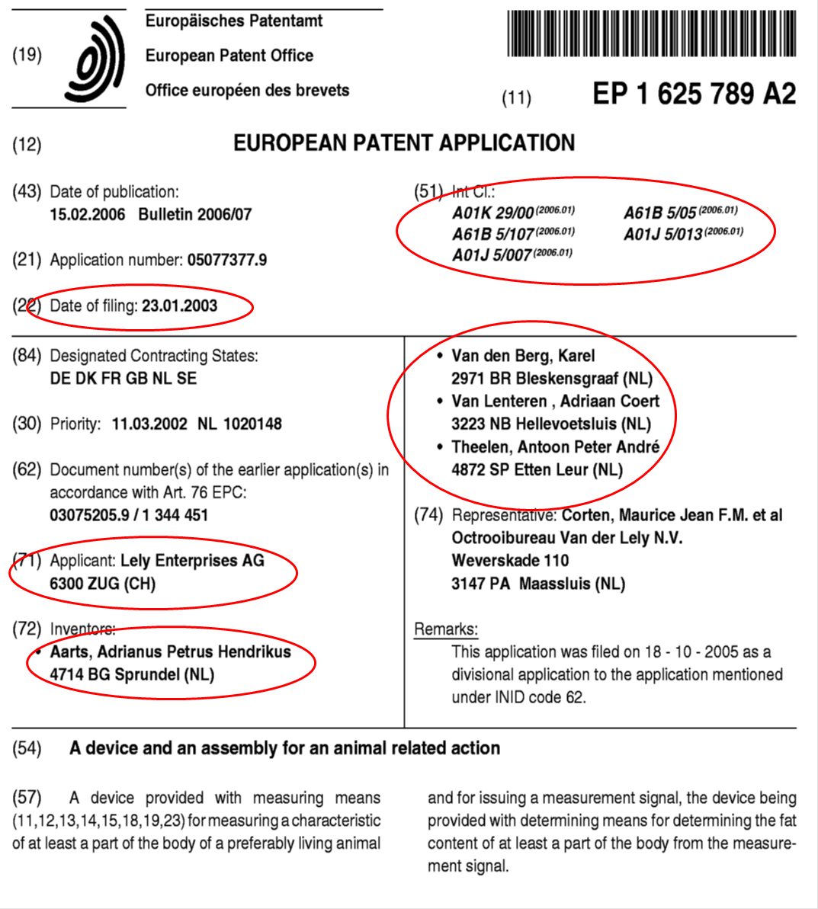

Slide 39
Results: Related vs Unrelated Variety
A region with higher variety can profit from higher learning opportunities (novelty of combination)
The learning opportunities generated by a variety are relevant if they are related. UV if weighted

Slide 40
Results: Cross-region externalities and their composition
Simillarity between the composition of the knowledge of within-the-region patents and that of the cross-regional patents: it matters
Relatedness between the technological sectors of the within-the-region patents and the sectors of the knowledge flows that come from co-patenting with inventors in other regions: effect if weighted patents

Slide 41
Conclusion
Certain diversity of knowledge allows to a better combination of ideas generating new knowledge
What matters is the process of cross-fertilization that results from the interplay of ideas belonging to different but related technological trajectories
Similarity between the within-the-region knowledge base and the knowledge that flows from other regions

Slide 42
Thank you for your attention! rmoreno@ub.edu

